Slide 1
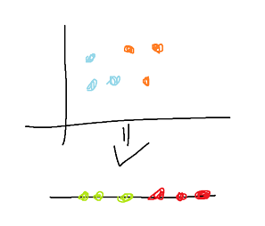
TSNE
High dimensional dataset to low while retaining information
Take high dimensional points and randomly put them in the low dimenison

Slide 2
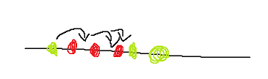
TSNE
Take first point and find out where it should move
See the points and there distances and find out if the point is attracted of not
When one force is stronger push the point in that direction
Do this for all the points that are in the list until no point wants to move

Slide 3
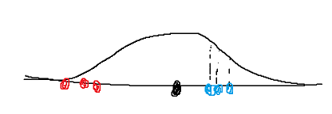
TSNE
Similarity of the points if found out by mesuring the distance of points to one point and plotting them on a normal curve.
The length of the line from the point to the curve is the similarity
All of this is scaled to one (score / all scores)
This is done for all points

Slide 4
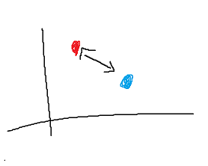
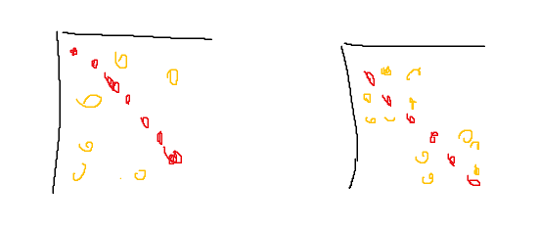
TSNE
For both directions of the distances an average will be taken
This gives a matrix of similarity scores
Now all of this will be done on the low dimensionality and it will use a t-distribution. (they would be more in the middle and therefore harder to see)
This will also give us a matrix
The low dim. Matrix tries to be like the high dim. Matrix

